Slide 1


Batool Alghoraibi
8/16/2023

Slide 2
Outline
Executive Summary
Introduction
Methodology
Results
Conclusion

Slide 3
Executive Summary
The aim of this research is to analyze data from SpaceX Falcon 9, which has been collected from various sources, and utilize Machine Learning models to predict the success of the first stage landing. This prediction capability provides other space agencies with the ability to determine whether they should compete with SpaceX.
Methodologies Summary:
Data collection, wrangling, and formatting
Exploratory data analysis
Interactive data visualization
Machine learning prediction
Summary of Results
This report will present the results in various formats, including:
Data analysis results
Data visualization and interactive dashboards
Predictive model analysis results

Slide 4
Introduction
Project background and context
With the recent advancements in private space travel, the space industry is becoming increasingly popular and accessible to the general population. However, the high cost of launches remains a significant barrier for new competitors entering the space race.
SpaceX, with its first stage reuse capabilities, holds a significant advantage over its competitors. Each SpaceX launch costs approximately $62 million, whereas other competitors spend around $165 million per launch, as SpaceX can reuse the first stage for future missions.
Problems you want to find answers
Determine the likelihood of successful landing for the first stage of SpaceX Falcon 9.
Investigate the impact of different parameters/variables on the landing outcomes, such as launch site, payload mass, booster version, and more.
Analyze the correlations between launch sites and success rates to understand if certain locations contribute to higher or lower landing success rates.

Slide 5

Section 1

Slide 6
Methodology
Executive Summary
Data collection methodology:
Data for this research was collected through two methods: accessing the SpaceX REST API and web scraping Wiki pages.
Perform data wrangling
Attribute Identification
Attribute Exploration
Outcome Conversion
Perform exploratory data analysis (EDA) using visualization and SQL
Perform interactive visual analytics using Folium and Plotly Dash
Perform predictive analysis using classification models
Created a column for ‘class’; standardized and transformed data; train/test split data; find best classification algorithm (Logistic regression, SVM, decision tree, & KNN) using test data

Slide 7
Data Collection
The data for this research was collected using two main methods: accessing the SpaceX REST API and performing web scraping.
SpaceX REST API:
1. API Provides Launch Info
2. GET Request in Python
3. JSON Response Received
4. JSON Data Normalized
Web Scraping:
1. Python BeautifulSoup
2. Scrape HTML Tables
3. Parse into Pandas DataFrame

Slide 8

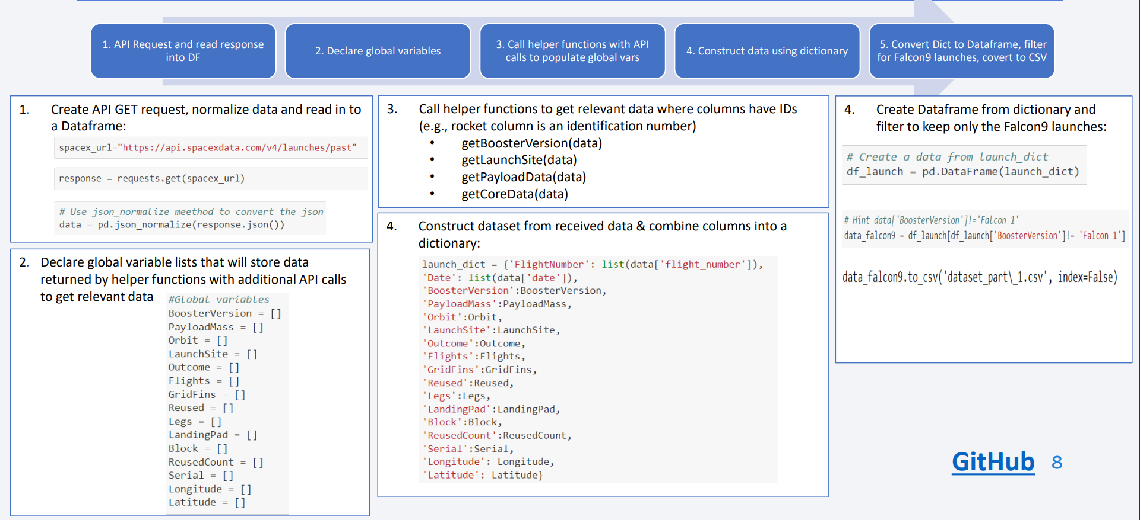
Data Collection – SpaceX API
GitHub

Slide 9
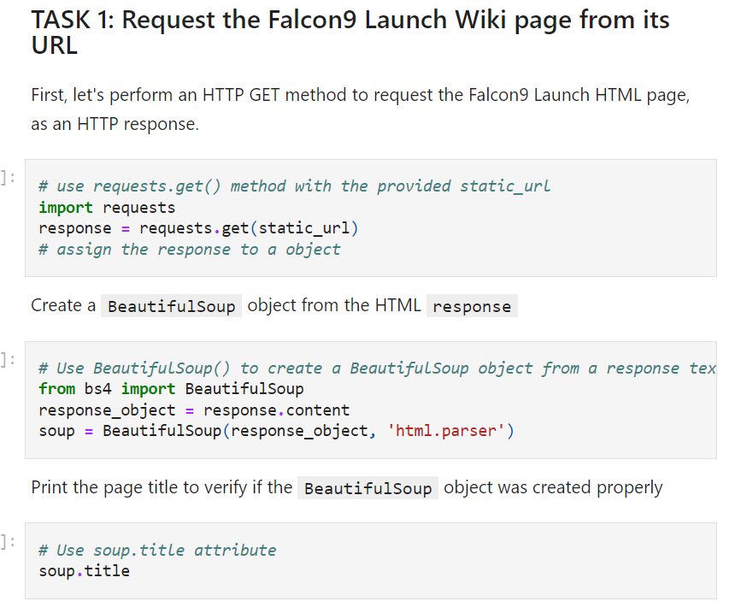
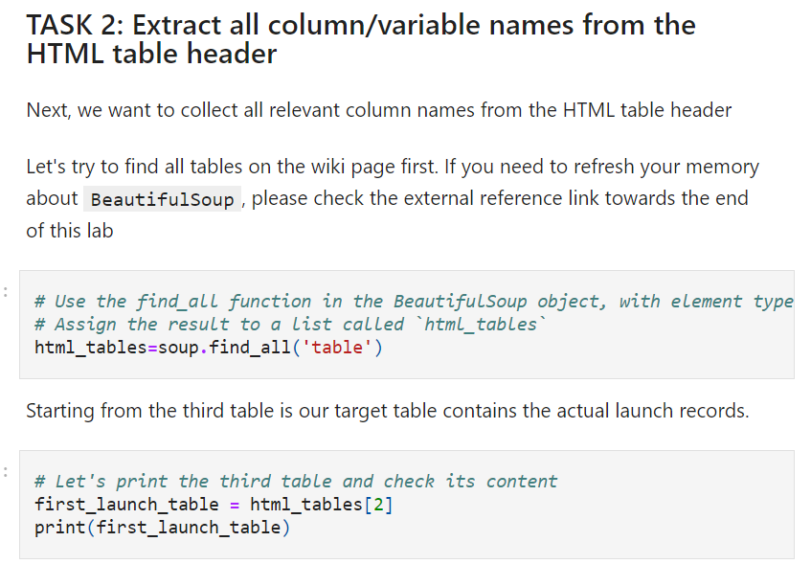
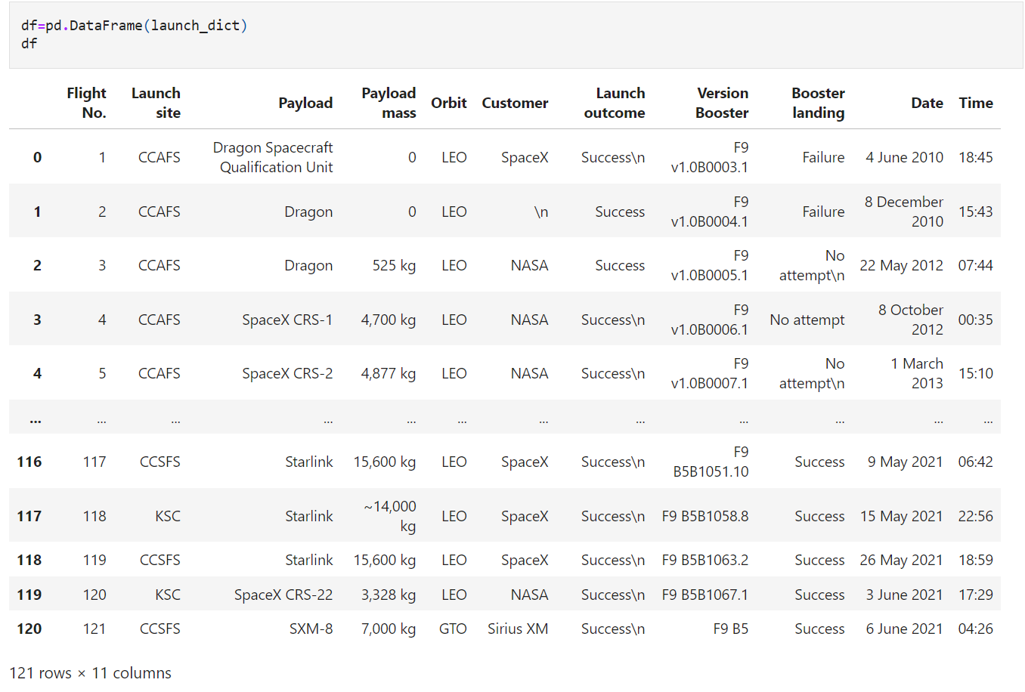
Data Collection - Scraping
1. Python BeautifulSoup
2. Scrape HTML Tables
3. Parse into Pandas DataFrame
GitHub

Slide 10
Data Wrangling
The data processing steps involved in this scenario can be summarized as follows:
Attribute Identification: Review and identify the relevant attributes or columns in the dataset, such as Flight Number, Date, Booster version, Payload mass, Orbit, Launch Site, Outcome, Grid Fins, Reused, Legs, Landing pad, Block, Reused count, Serial, Longitude, and Latitude of launch.
Attribute Exploration: Examine the specific details and categories within certain attributes. For example, explore the launch sites, categorize orbits into LEO and GTO, and analyze the outcomes of successful and unsuccessful landings.
Outcome Conversion: Define the desired conversion of landing outcomes to classes. Assign "0" for unsuccessful landings and "1" for successful landings. Designate the variable "Y" as the classification variable representing the outcome of each launch.
By following these steps, the dataset is prepared with identified attributes, explored attribute details, and converted landing outcomes for further analysis and modeling.

Slide 11
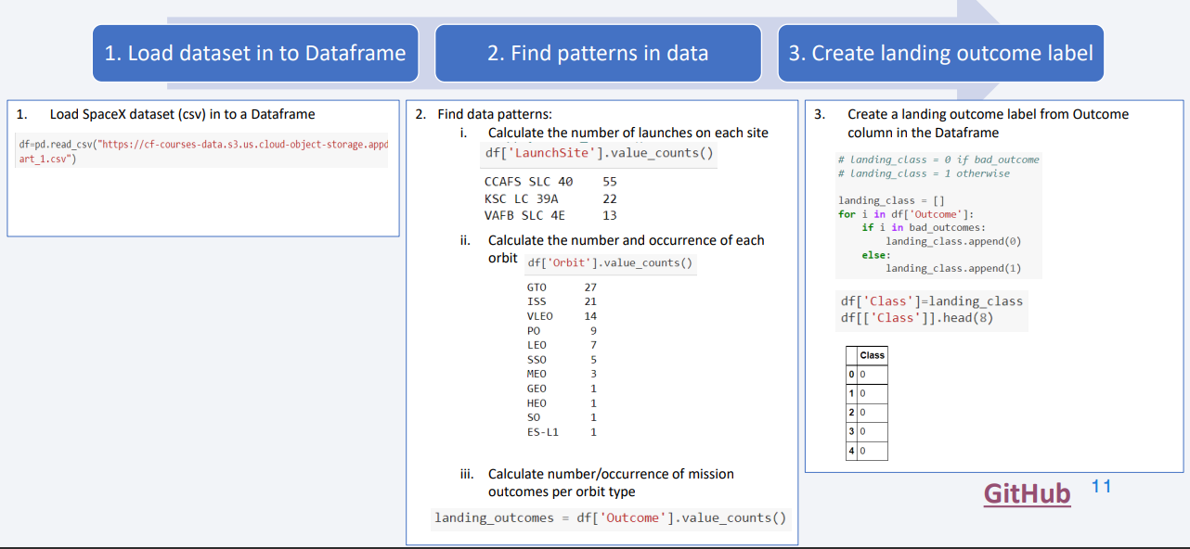
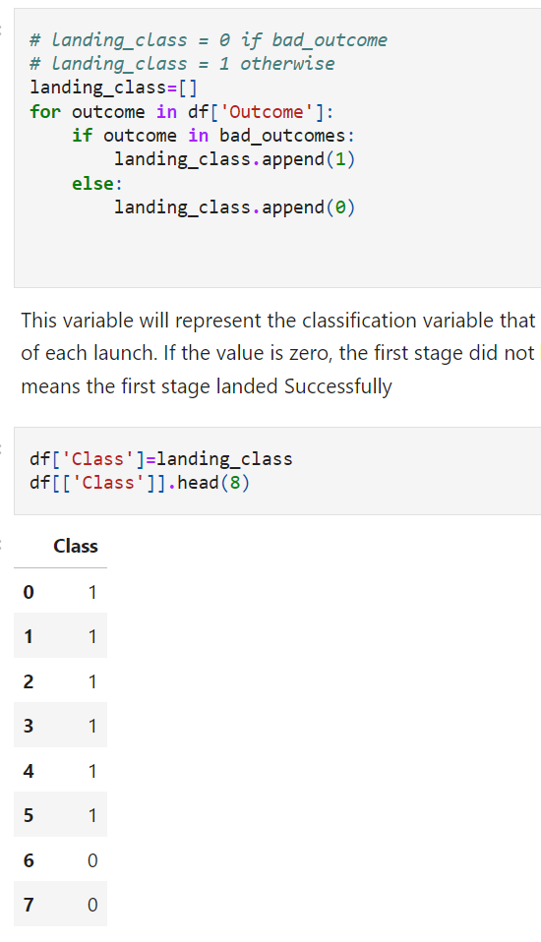
Data Wrangling
GitHub

Slide 12
EDA with Data Visualization
The following relationships were represented using pandas, numpy and seaborn libraries:
The relationship between Flight Number and Launch Site using scatter point
the relationship between Payload and Launch Site using scatter point
the relationship between success rate of each orbit type using bar chart
the relationship between FlightNumber and Orbit type using scatter plot
the relationship between Payload and Orbit type using scatter point chart
the launch success yearly trend using line chart
GitHub

Slide 13
EDA with SQL
Display the names of the unique launch sites in the space mission
Display 5 records where launch sites begin with the string 'CCA’
Display the total payload mass carried by boosters launched by NASA (CRS)
Display average payload mass carried by booster version F9 v1.1
List the date when the first succesful landing outcome in ground pad was acheived.
List the names of the boosters which have success in drone ship and have payload mass greater than 4000 but less than 6000
List the total number of successful and failure mission outcomes
List the names of the booster_versions which have carried the maximum payload mass.
List the records which will display the month names, failure landing_outcomes in drone ship ,booster versions, launch_site for the months in year 2015.
Rank the count of landing outcomes (such as Failure (drone ship) or Success (ground pad)) between the date 2010-06-04 and 2017-03-20
GitHub

Slide 14
Build an Interactive Map with Folium
Markers of all Launch Sites:
A marker with a circle, popup label, and text label of the NASA Johnson Space Center was added using its latitude and longitude coordinates as the starting location.
Markers with circles, popup labels, and text labels of all Launch Sites were added using their latitude and longitude coordinates to display their geographical locations and proximity to the Equator and coasts. Colored markers of the launch outcomes for each Launch Site:
Colored markers indicating success (green) and failed (red) launches were added using a Marker Cluster to identify launch sites with relatively high success rates. Distances between a Launch Site and its proximities:
Colored lines were added to illustrate the distances between the Launch Site and its proximities such as the railway and coastline.
GitHub

Slide 15
Build a Dashboard with Plotly Dash
Launch Sites Dropdown List:
Implemented a dropdown list to allow users to select a Launch Site.
Pie Chart showing Success Launches (All Sites/Certain Site):
Created a pie chart to display the total count of successful launches for all sites, and if a specific Launch Site is selected, the chart shows the success vs. failed counts for that site.
Slider of Payload Mass Range:
Added a slider that allows users to select a range for the Payload mass.
Scatter Chart of Payload Mass vs. Success Rate for the different Booster Versions:
Generated a scatter chart to visualize the relationship between Payload mass and Launch Success rate for different Booster versions.
GitHub

Slide 16
Predictive Analysis (Classification)
Creating a NumPy array from the "Class" column in the data.
Standardizing the data using StandardScaler, and then fitting and transforming it.
Splitting the data into training and testing sets using the train_test_split function.
Creating a GridSearchCV object with cv=10 to find the best parameters.
Applying GridSearchCV on LogReg, SVM, Decision Tree, and KNN models.
Calculating the accuracy on the test data using the .score() method for all models.
Examining the confusion matrix for all models.
Finding the method that performs best by examining the Jaccard score and F1 score metrics.
GitHub

Slide 17

Results
Exploratory data analysis results
Interactive analytics demo in screenshots
Predictive analysis results

Slide 18

Section 2

Slide 19
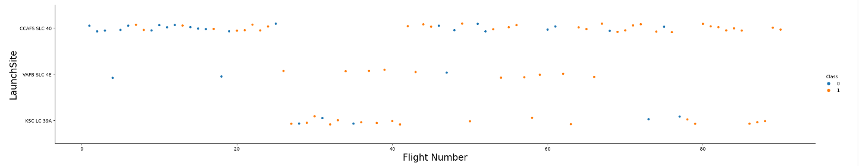
Flight Number vs. Launch Site
• The earliest flights in the dataset were unsuccessful, while the latest flights were all successful. This indicates a potential improvement in launch success over time. • The CCAFS SLC 40 launch site accounts for approximately half of all launches in the dataset, suggesting it is a commonly used site. • The VAFB SLC 4E and KSC LC 39A launch sites have shown higher success rates compared to other sites. This implies that these sites may have better launch conditions or operational procedures. • Based on the observed data, it can be inferred that newer launches tend to have a higher rate of success. This suggests that advancements in technology or improved launch processes contribute to increased success rates over time.

Slide 20
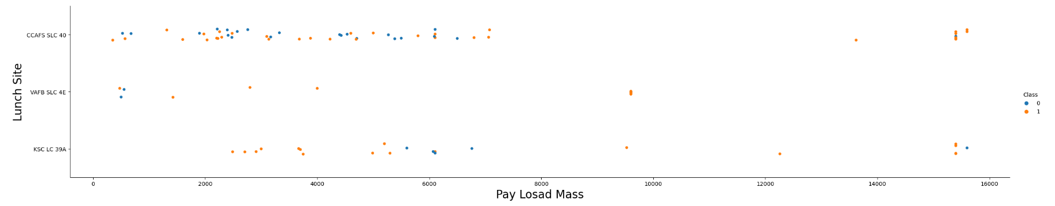
Payload vs. Launch Site
• The data analysis reveals that there is a positive correlation between the payload mass and the success rate for each launch site. In other words, as the payload mass increases, the likelihood of a successful launch also increases. • It is observed that a majority of launches with a payload mass exceeding 7000 kg have been successful. This suggests that the launch sites have the capability and infrastructure to handle larger payloads effectively. • Moreover, the specific launch site KSC LC 39A stands out with a 100% success rate for payload masses under 5500 kg as well. This indicates that the site has demonstrated consistent success even for relatively lower payload masses, showcasing its reliability and efficiency.

Slide 21
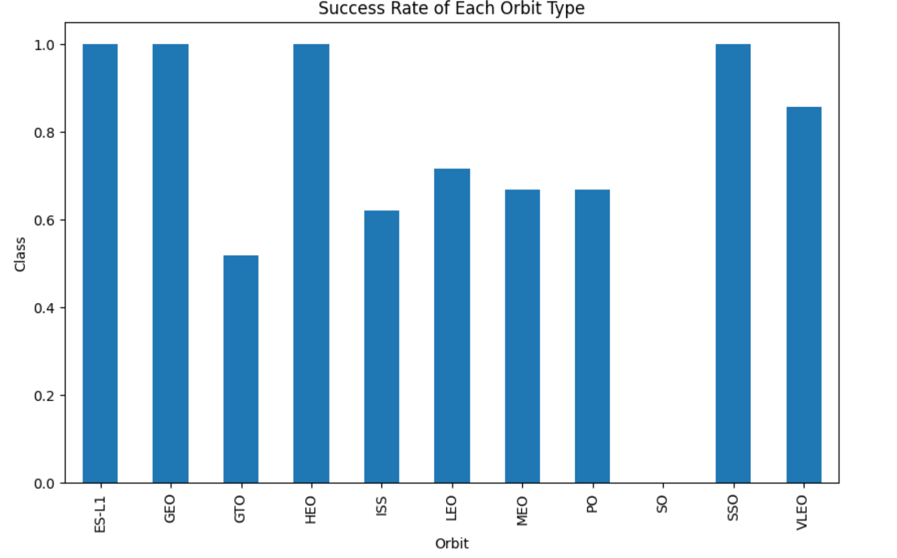
Success Rate vs. Orbit Type
Orbits with 100% success rate: - ES-L1, GEO, HEO, SSO
Orbits with 0% success rate: - SO
Orbits with success rate between 50% and 85%: - GTO, ISS, LEO, MEO, PO

Slide 22
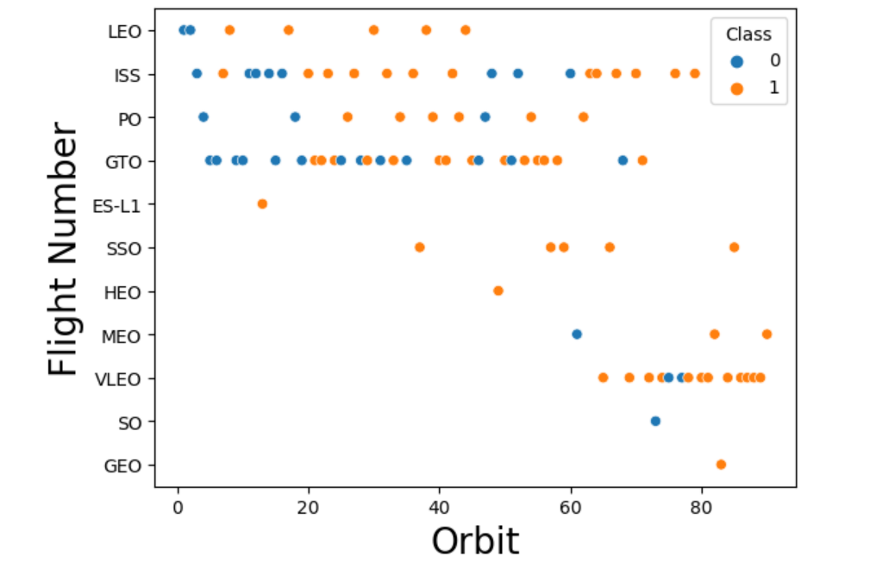
Flight Number vs. Orbit Type
• In LEO orbit, there is a positive correlation between the success rate and the number of flights, indicating improved success with more launches. • However, in GTO orbit, there is no apparent relationship between the flight number and the success rate, suggesting other factors influence success in this orbit.

Slide 23
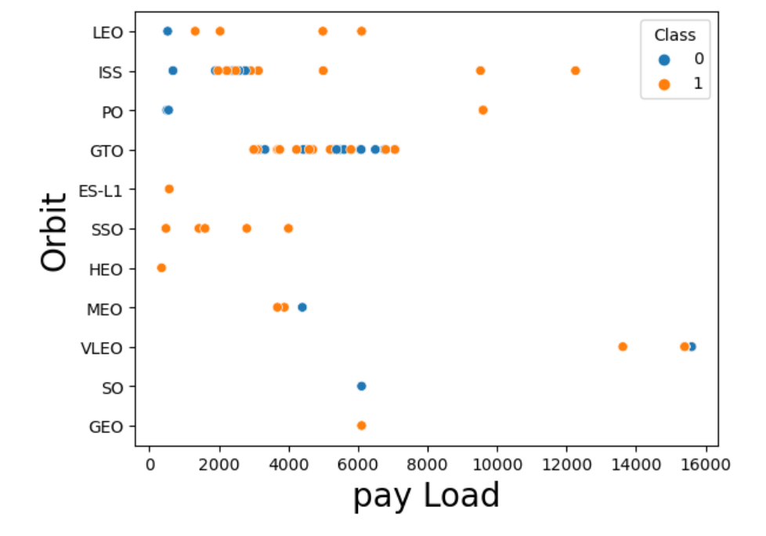
Payload vs. Orbit Type
• Heavy payloads have a negative influence on GTO orbits and positive on GTO and Polar LEO (ISS) orbits

Slide 24
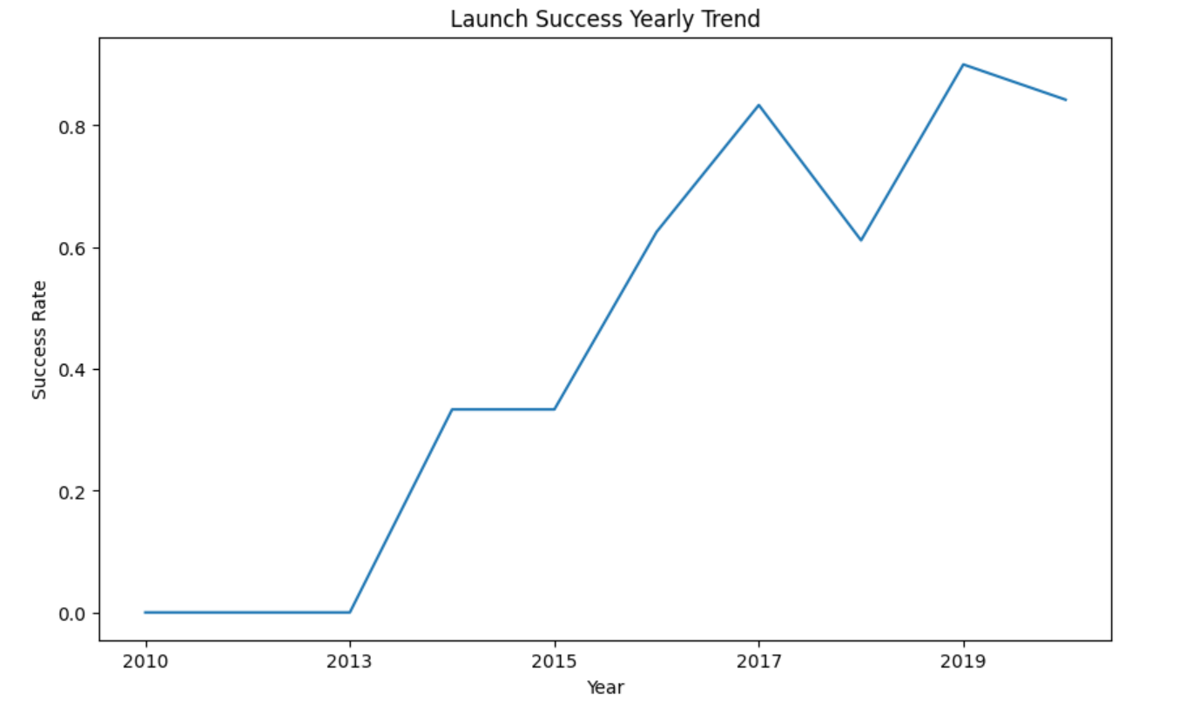
Launch Success Yearly Trend
The success rate since 2013 kept increasing till 2020

Slide 25
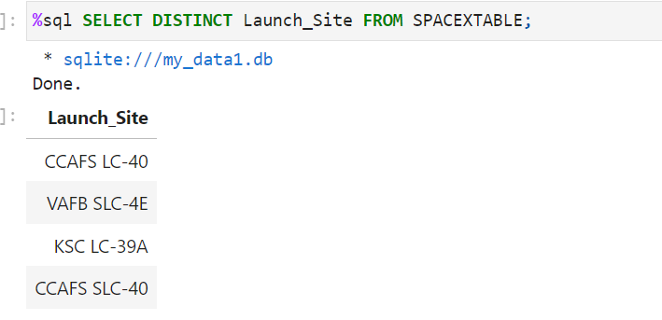
All Launch Site Names
Displaying the names of the unique launch sites in the space mission

Slide 26
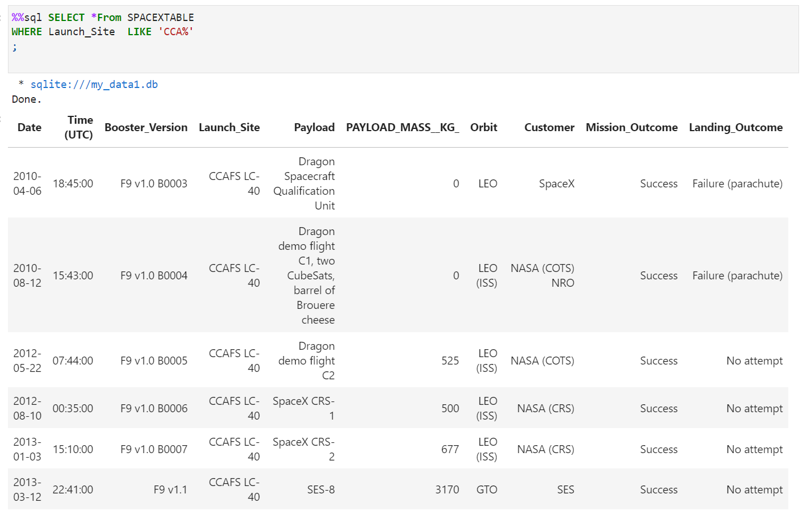
Launch Site Names Begin with 'CCA'
Displaying 5 records where launch sites begin with the string 'CCA'.

Slide 27
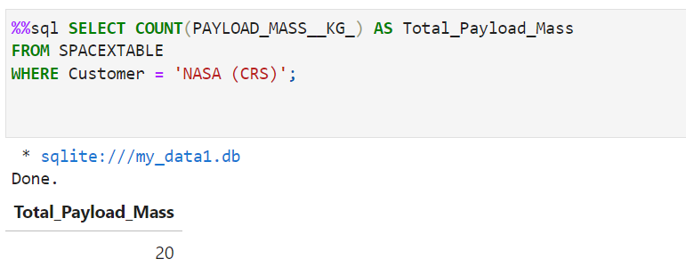
Displaying the total payload mass carried by boosters launched by NASA (CRS).
Total Payload Mass

Slide 28
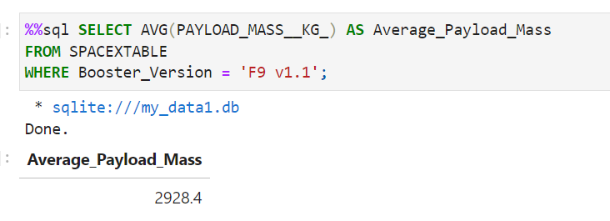
Displaying average payload mass carried by booster version F9 v1.1
Average Payload Mass by F9 v1.1

Slide 29
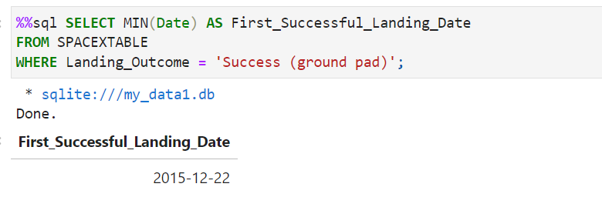
First Successful Ground Landing Date
Listing the date when the first successful landing outcome in ground pad was achieved

Slide 30
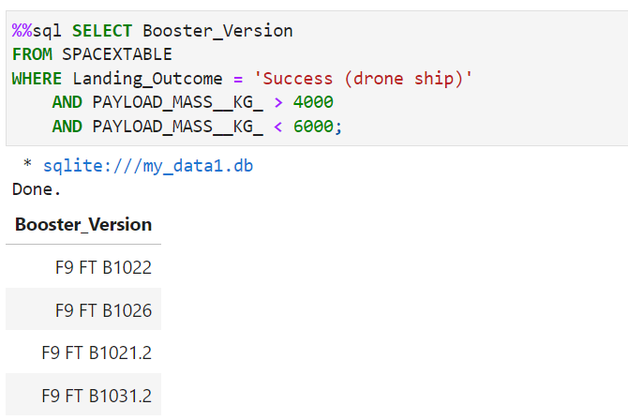
Successful Drone Ship Landing with Payload between 4000 and 6000
Listing the names of the boosters which have success in drone ship and have payload mass greater than 4000 but less than 6000

Slide 31
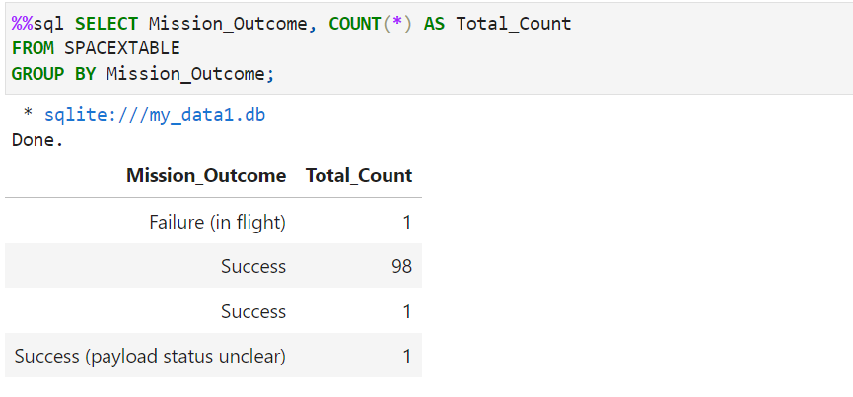
Listing the total number of successful and failure mission outcomes.
Total Number of Successful and Failure Mission Outcomes

Slide 32
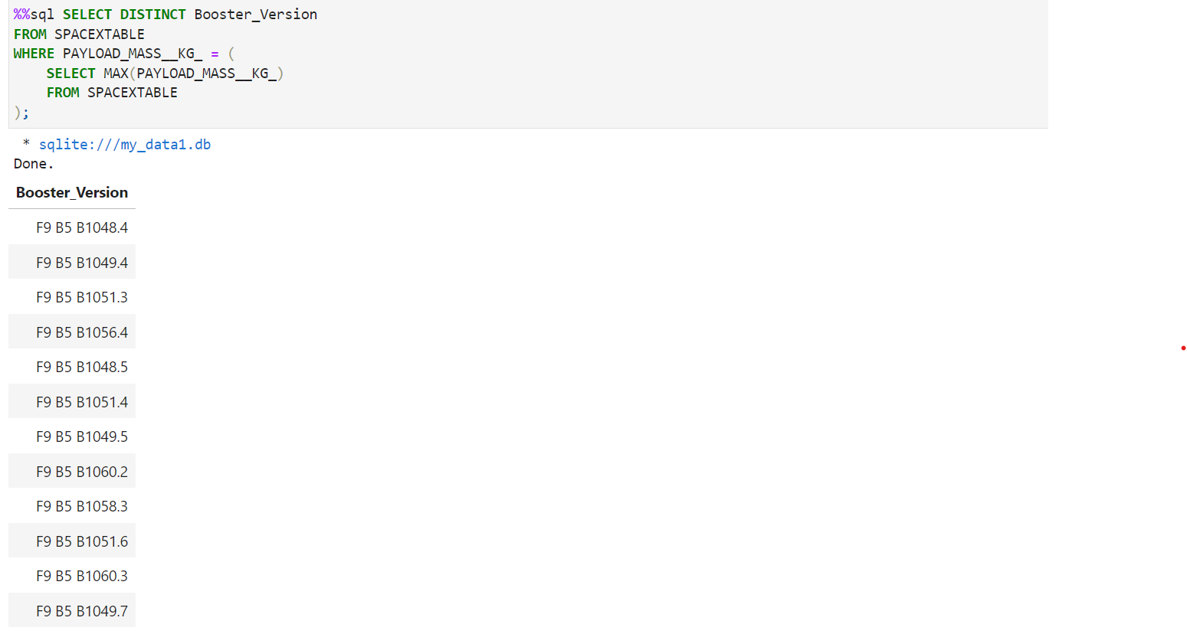
Boosters Carried Maximum Payload
Listing the names of the booster versions which have carried the maximum payload mass

Slide 33
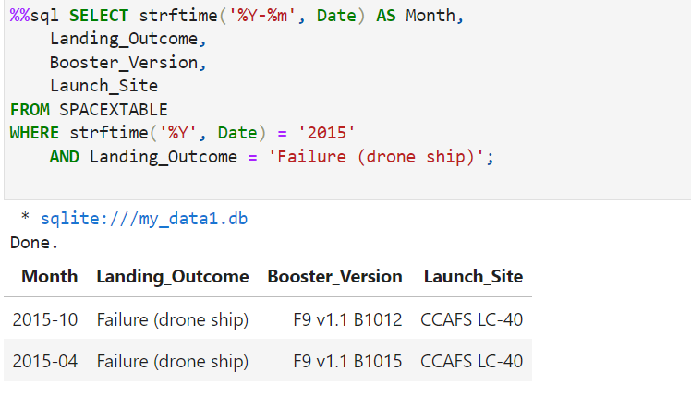
2015 Launch Records
Listing the failed landing outcomes in drone ship, their booster versions and launch site names for the months in year 2015

Slide 34
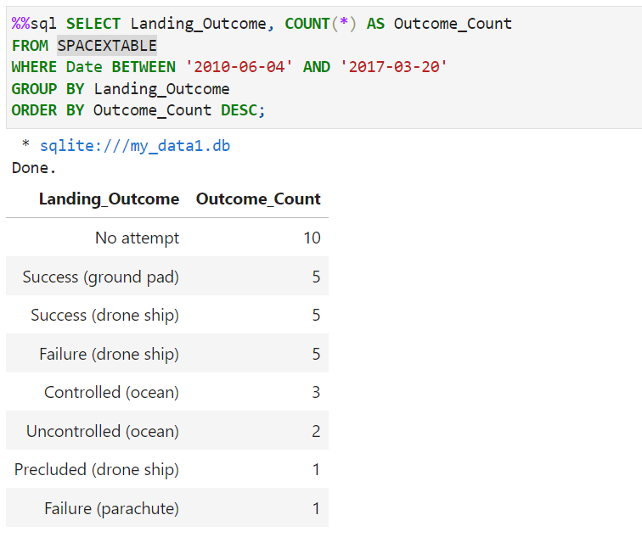
Rank Landing Outcomes Between 2010-06-04 and 2017-03-20
Ranking the count of landing outcomes (such as Failure (drone ship) or Success (ground pad)) between the date 2010-06-04 and 2017-03-20 in descending order.

Slide 35

Section 3

Slide 36
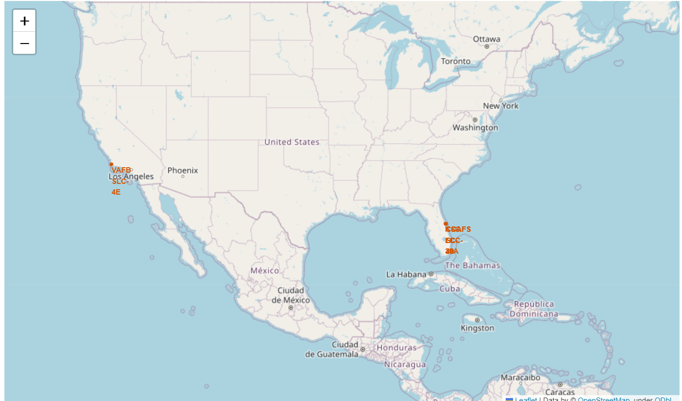
All launch sites location markers on a global map
All launch sites are situated near coastlines. Launching rockets towards the ocean reduces the risk of debris falling or exploding near populated areas, enhancing safety measures during launches.

Slide 37
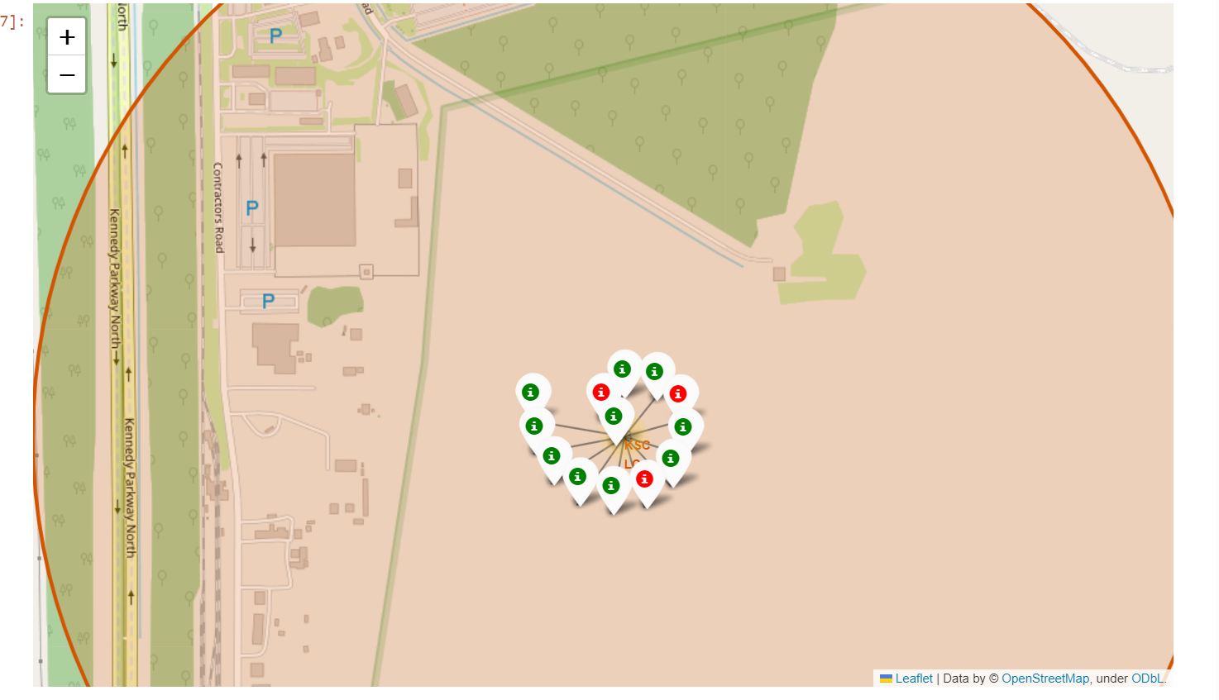
Colour-labeled launch records on the map
• From the colour-labeled markers we should be able to easily identify which launch sites have relatively high success rates.
- Green Marker = Successful Launch - Red Marker = Failed Launch
• Launch Site KSC LC-39A has a very high Success Rate

Slide 38
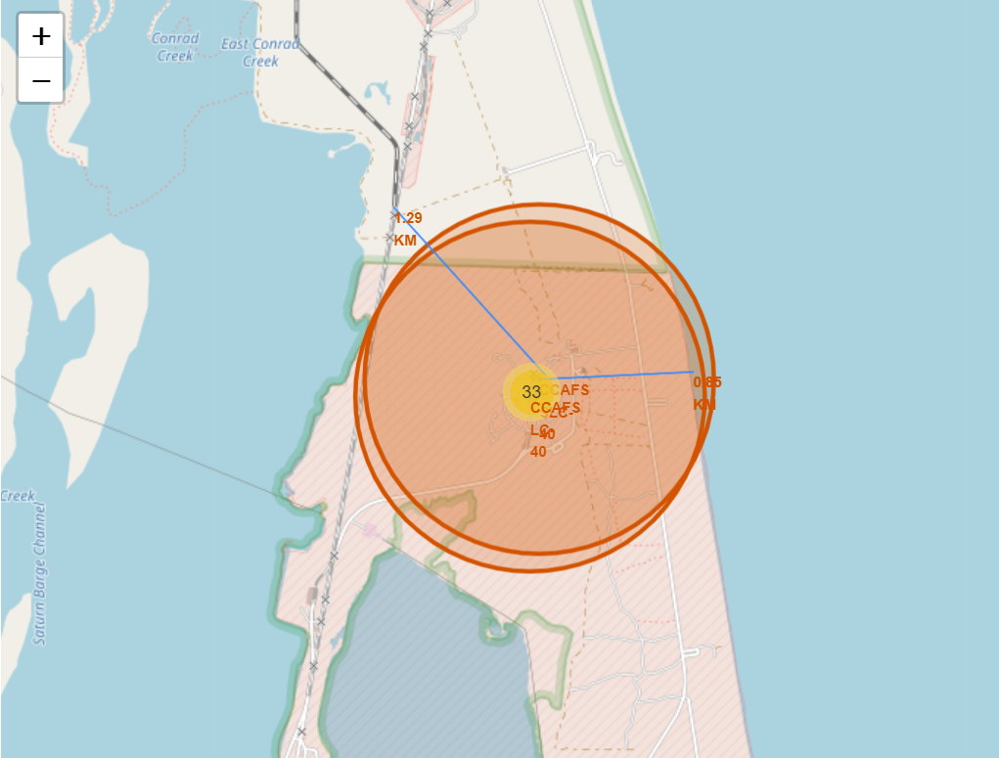
Distance from the launch site CCAFS SLC-40 to its proximities
• Upon visual analysis of the launch site CCAFS SLC-40 , it is evident that it is in close proximity to various features:
It is relatively close to a railway, approximately 1.29 km away.
It is relatively close to the coastline, approximately 0.85km away.

Slide 39

Section 4

Slide 40
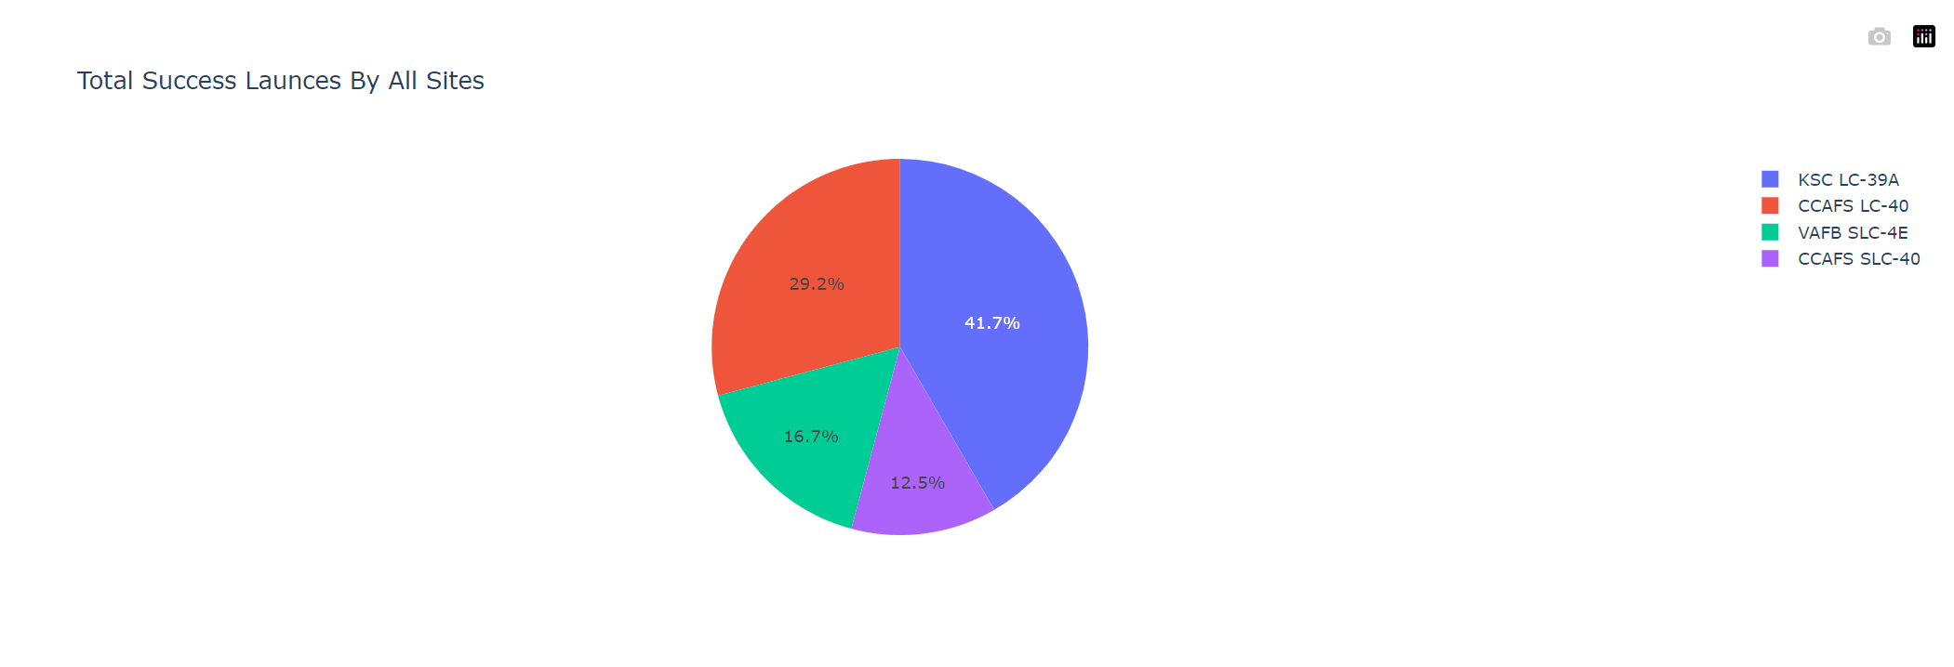
Launch success count for all sites
The chart clearly shows that from all the sites, KSC LC-39A has the most successful launches.

Slide 41
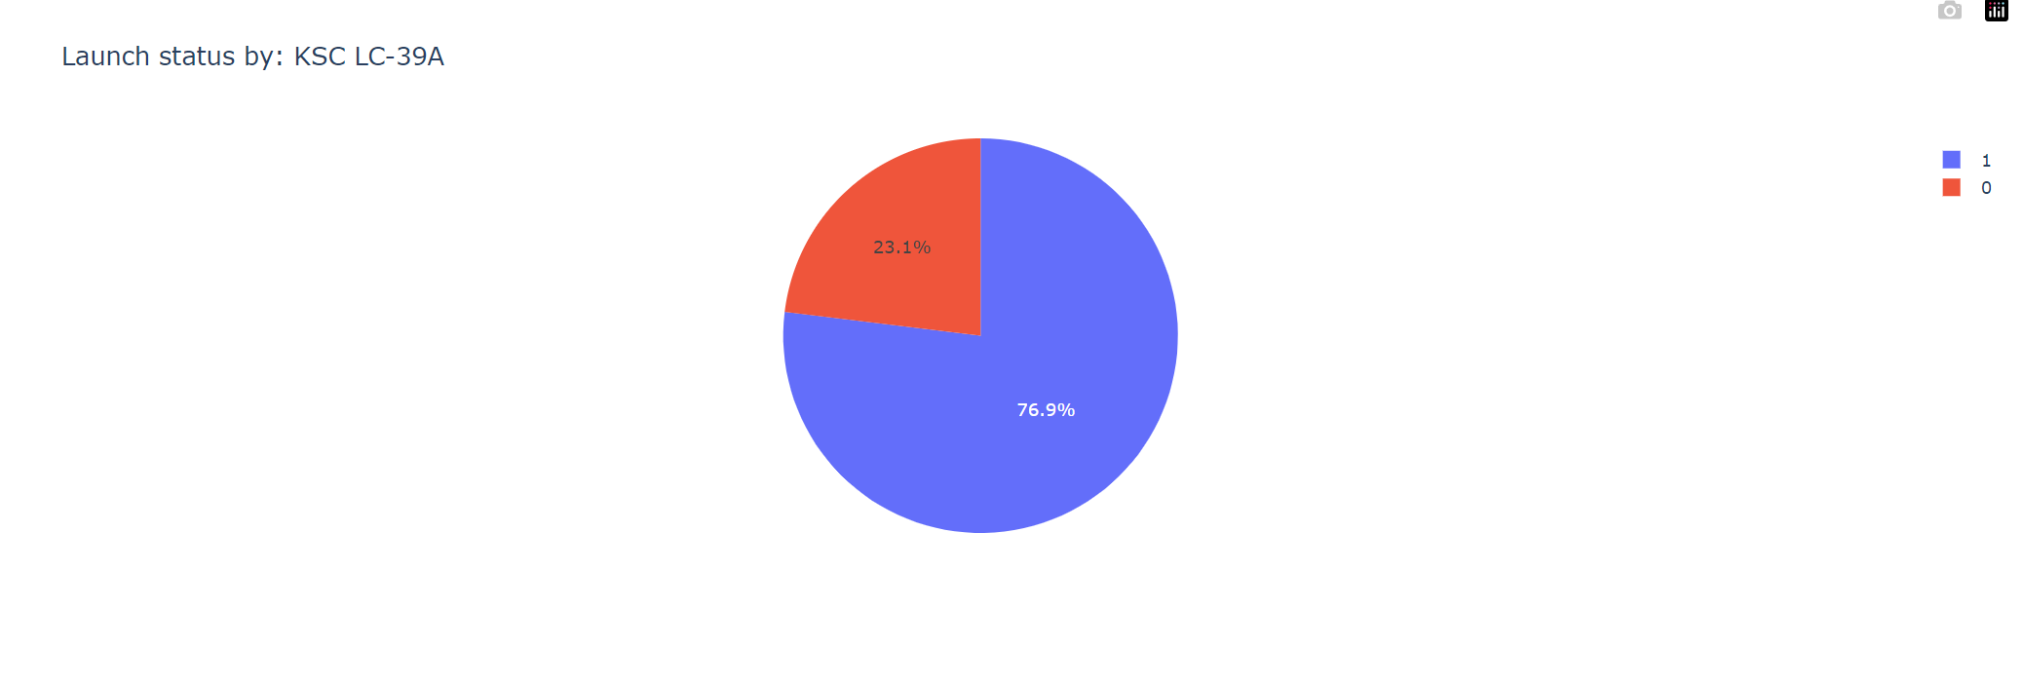
Launch site with highest launch success ratio
KSC LC-39A has the highest launch success rate (76.9%) with 10 successful and only 3 failed landings

Slide 42
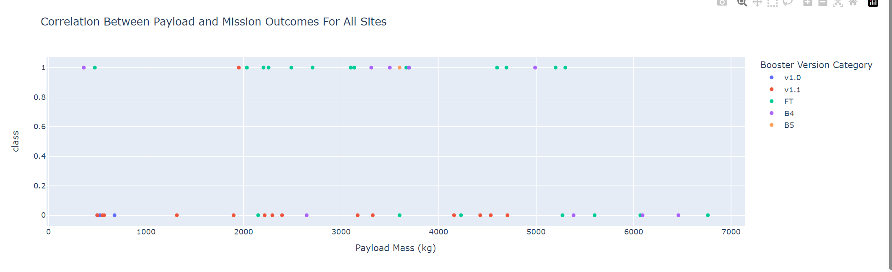
Payload Mass vs. Launch Outcome for all sites
The charts show that payloads between 2000 and 5500 kg have the highest success rate.

Slide 43

Section 5

Slide 44

Predictive Analysis
Logistic regression
GridSearchCV best score: 0.8464285714285713
Accuracy score on test set: 0.8333333333333334
Confusion matrix:

Slide 45
Predictive Analysis
Support vector machine (SVM)
GridSearchCV best score: 0.8482142857142856
Accuracy score on test set: 0.8333333333333334
Confusion matrix:

Slide 46
Predictive Analysis
Decision tree
GridSearchCV best score:0.875
Accuracy score on test set: 0.8333333333333334
Confusion matrix:

Slide 47
Predictive Analysis
K nearest neighbors (KNN)
GridSearchCV best score: 0.8482142857142858
Accuracy score on test set: 0.8333333333333334
Confusion matrix:

Slide 48

Predictive Analysis
Comparing the results of all four models, it is evident that they have identical accuracy scores and confusion matrices when evaluated on the test set. Therefore, their rankings are determined based on their GridSearchCV best scores. The models are ranked as follows, with the first being the best and the last being the worst:
Decision tree (GridSearchCV best score: 0.8892857142857142)
K nearest neighbors, KNN (GridSearchCV best score: 0.8482142857142858)
Support vector machine, SVM (GridSearchCV best score: 0.8482142857142856)
Logistic regression (GridSearchCV best score: 0.8464285714285713)

Slide 49

Conclusions
In this project, we try to predict if the first stage of a given Falcon 9 launch will land in order to determine the cost of a launch
Launches with a lower payload mass tend to have higher success rates compared to launches with larger payload masses.
The majority of launch sites are located near the Equator line, and all launch sites are situated in close proximity to coastlines.
The success rate of launches has shown an upward trend over the years, indicating improvements in launch capabilities and processes.
Among all the launch sites, KSC LC-39A stands out with the highest success rate for its launches.
Launches into ES-L1, GEO, HEO, and SSO orbits have achieved a 100% success rate, indicating a high level of reliability and precision in reaching these specific orbits.

Slide 50

Appendix
https://github.com/Batool1227/Apllied-DataScince.git

Slide 51


